Slide 1
TEAM SMART WORKERS| Transport Decision Making
DAEN 690 - Capstone Project FALL 2021 - Professor F. Brett Berlin

Slide 2

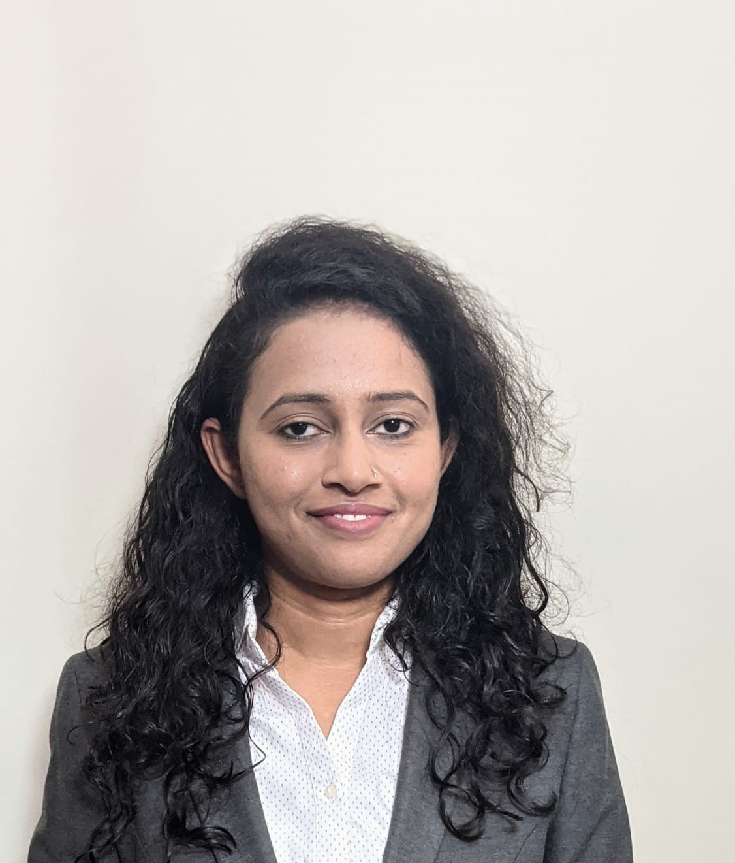




TEAM SMART WORKERS- MEMBERS & MENTORS
Mentors:
Professor F Brett Berlin
Stephen Hartman
Deepa Kapse
Product Owner & Developer
Jessica LeBlanc
John Morrison
Yashashree Panda
Scrum Master
Vaishnavi Rajput Developer
Harshita Thurlapati
Developer
Suraj Reddy Alimineti Developer

Slide 3
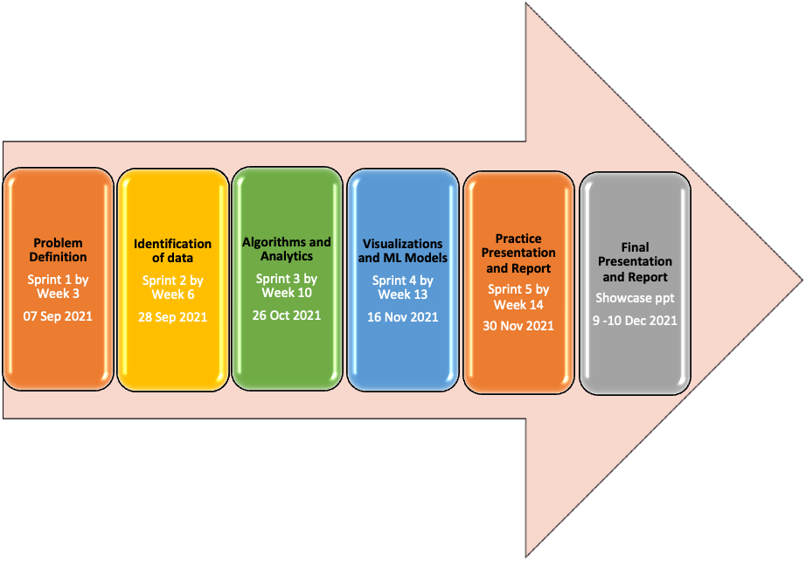

TEAM SMART WORKERS- AGILE DEVELOPMENT

Slide 4
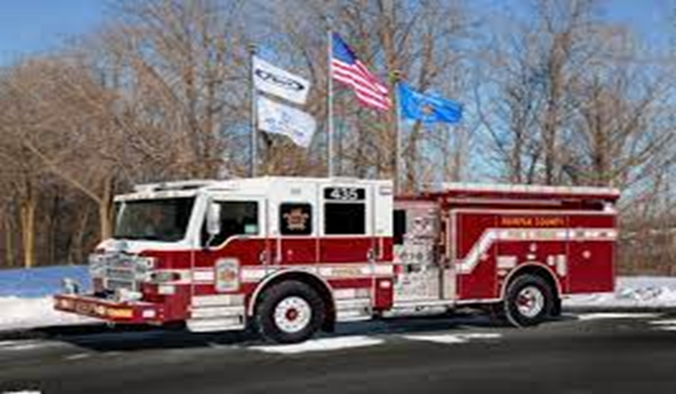
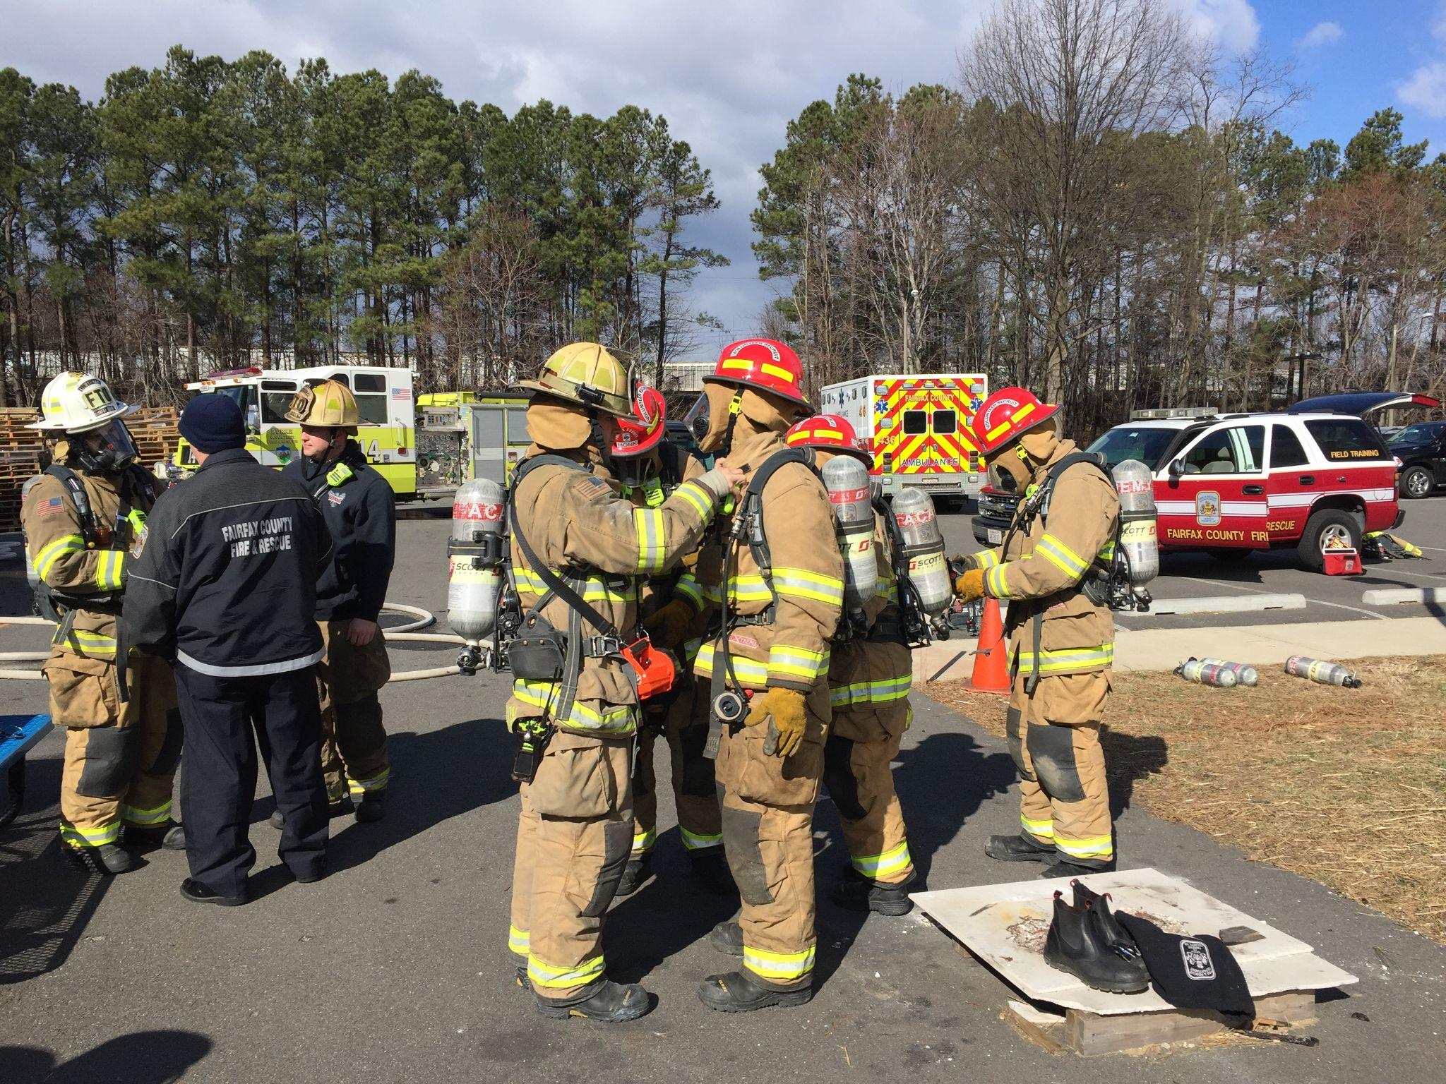

TEAM SMART WORKERS- PROBLEM CONTEXT
Problem Context:
Domain of problem: Public safety
Importance of problem: Fairfax County Fire and Rescue department provides emergency services to save lives of people.
Problem Statement:
The FRD doesn’t currently have any mechanism to evaluate the performance of the system as a whole.
The FRD desires to visualize and find anomalies in the present transport decisions.

Slide 5
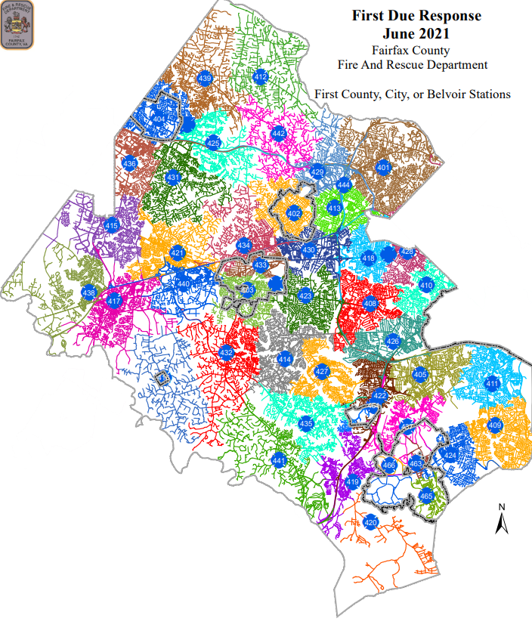
TEAM SMART WORKERS- MAP OF FRD

Slide 6


TEAM SMART WORKERS- ABOUT DATA
FACILITIES DATA
Facility_Name | Facility_Location_Code
Facility_Full_Address | Facility_Type_Of_Facility
Latitude and Longitude | Facility_Hospital_Designation_List

Slide 7
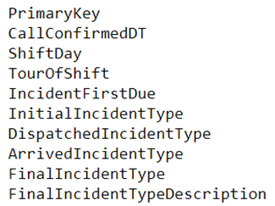
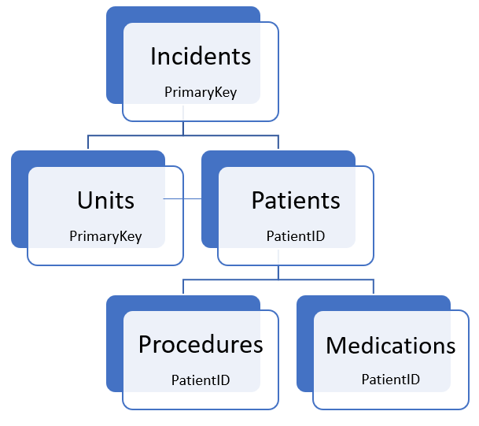

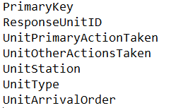
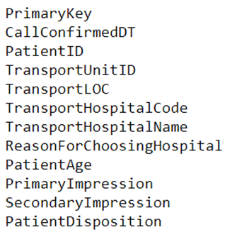
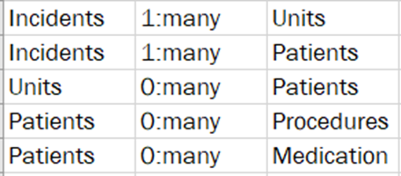
TEAM SMART WORKERS- ABOUT DATA
INDIVIDUAL TABLES DATA

Slide 8
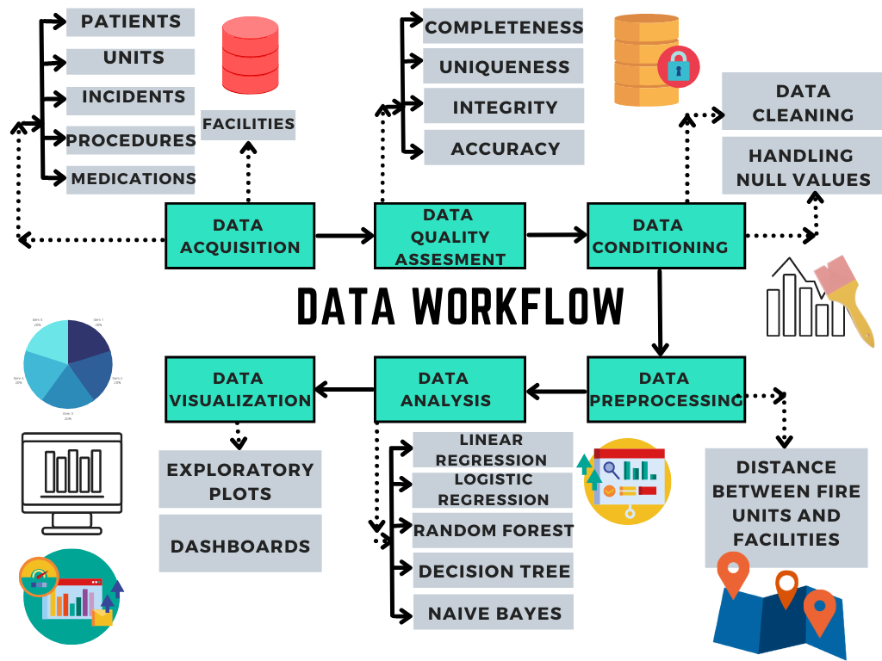
TEAM SMART WORKERS- WORKFLOW

Slide 9
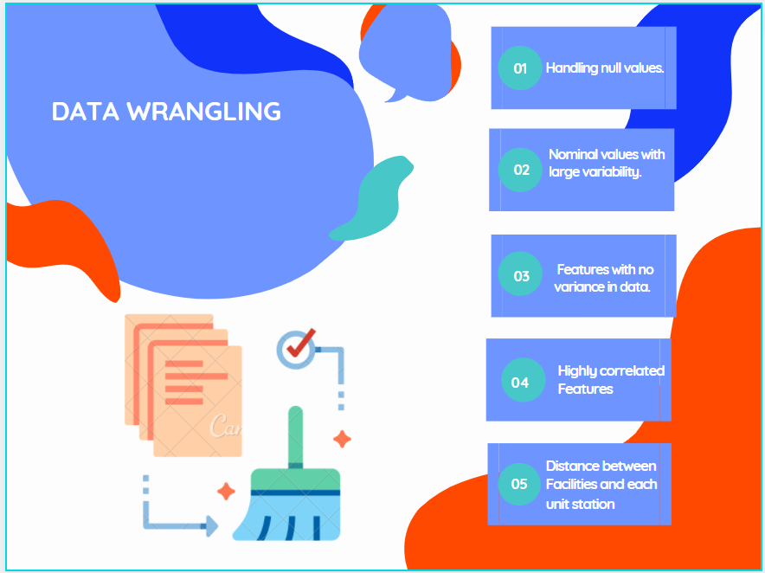
TEAM SMART WORKERS- DATA WRANGLING
Handling null values.
Dropped nominal values with large variability.
Dropped features with no variance in data.
Dropped highly correlated features.
Calculated distance between facilities and each unit station using Haversine formula.
Data transformation for merging datasets.
Incidents
Units
Patients
Facilities

Slide 10
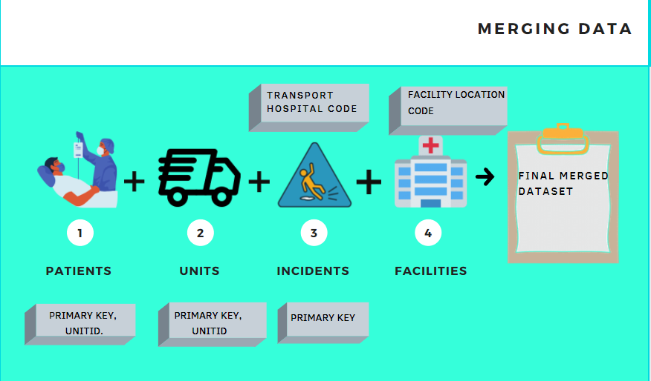
TEAM SMART WORKERS- DATA WRANGLING

Slide 11

TEAM SMART WORKERS- MODELING STRATEGY
Performed analysis on the merged dataset.
Performed analysis and predictions on Units, Incidents, Patients and Facilities merged dataset.
Model Performance with and without important features.
Decision Tree.
Random Forest.
Logistic Regression.
LightGBM.
Checked the model performance and feature importance by hyper parameter tuning.
Modeling using GridsearchCV.
Outcome variable was ‘Transport Hospital Name’

Slide 12
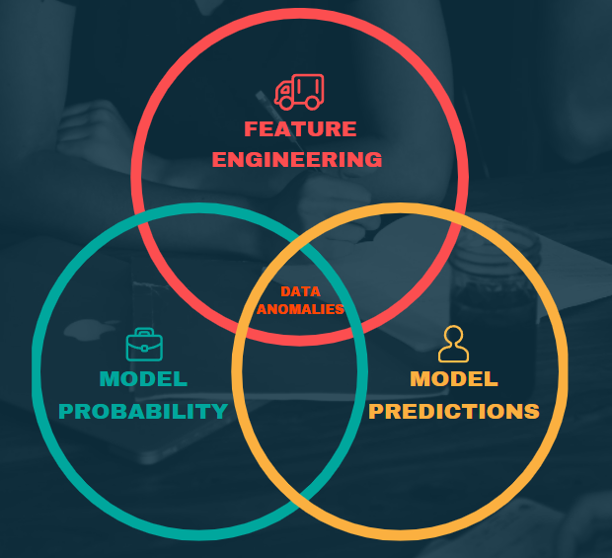
TEAM SMART WORKERS- MODELING
Feature Importance.
For the model we obtained the model probability and predictions.
The percentage of mismatch in predictions were found using the formulae:
(mismatch_count / total_count )*100
Set confidence threshold, minimum number of records, filter by features to retrieve subset of model predictions and related anomalies.

Slide 13
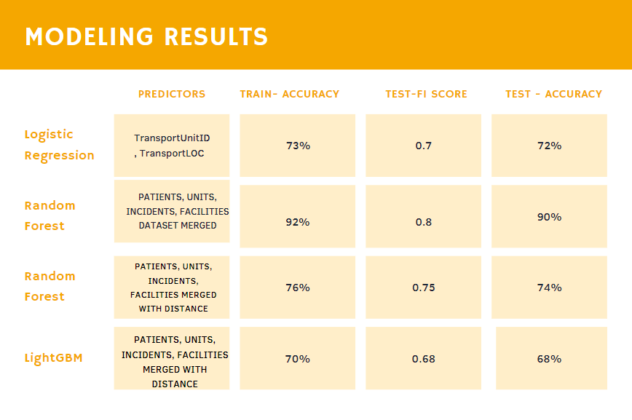
TEAM SMART WORKERS- MODELING RESULTS

Slide 14
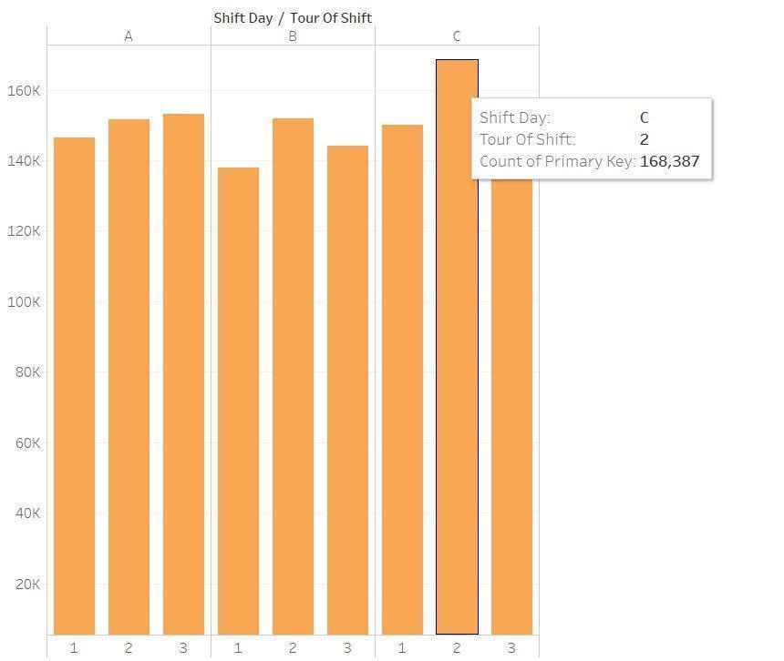
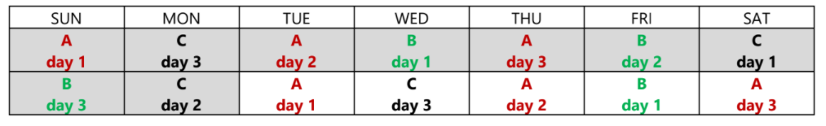
TEAM SMART WORKERS- VISUALIZATIONS

Slide 15
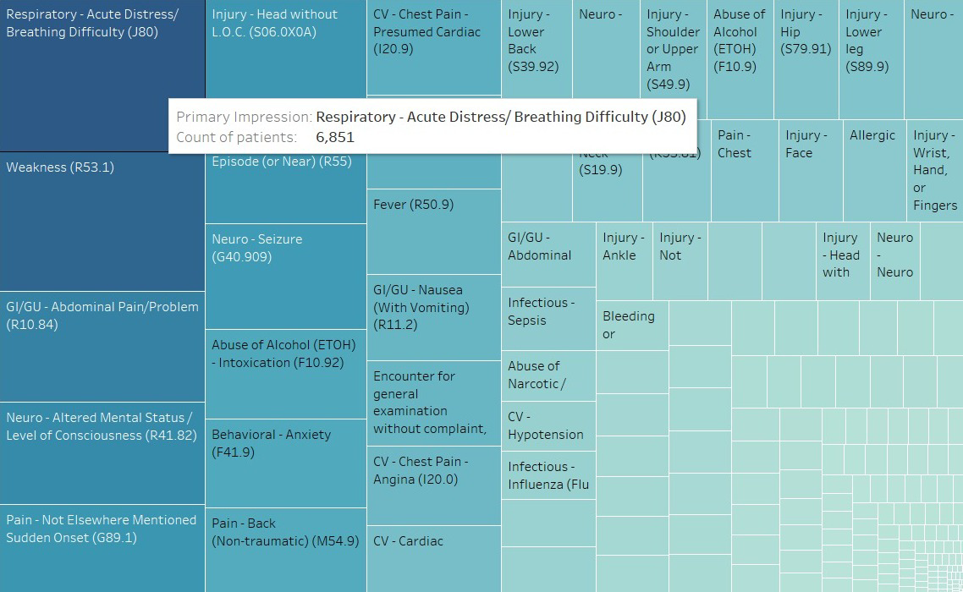
TEAM SMART WORKERS- VISUALIZATIONS

Slide 16
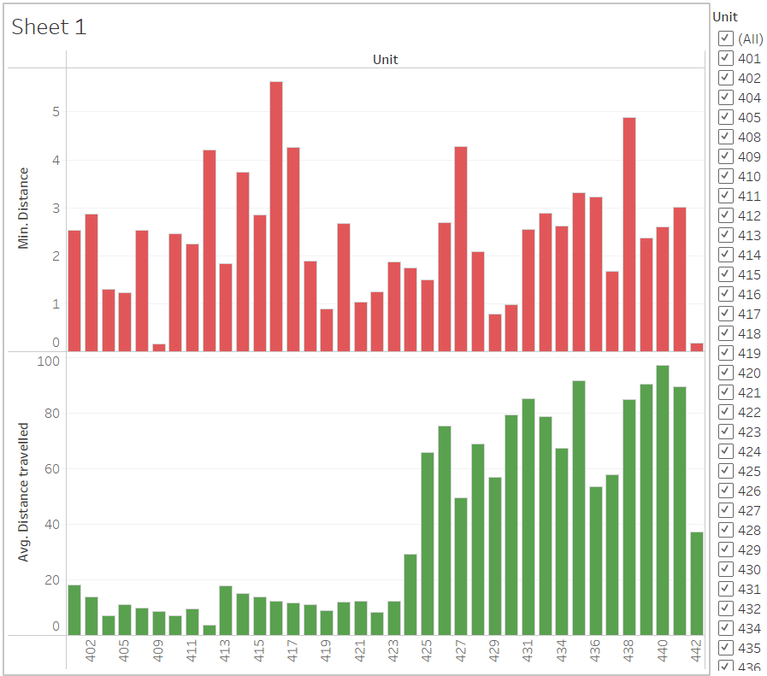
TEAM SMART WORKERS- VISUALIZATIONS

Slide 17
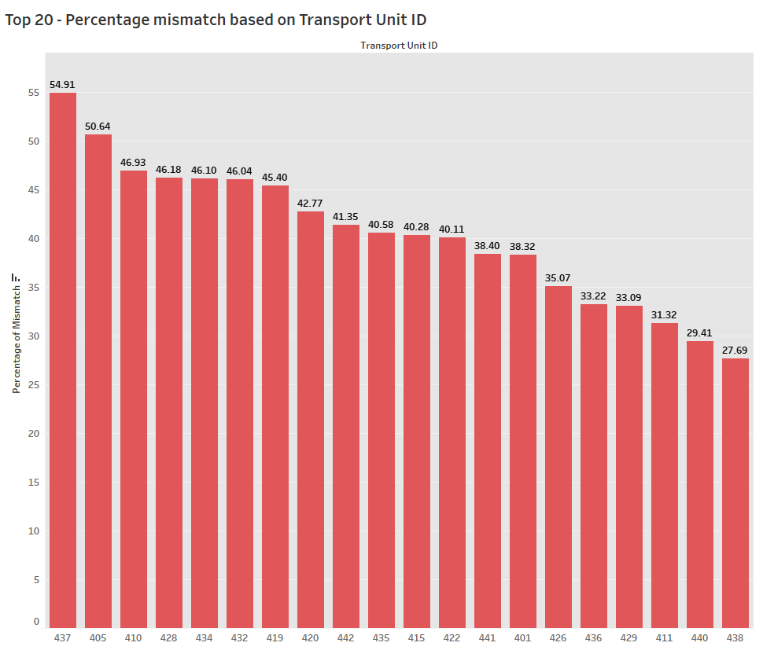
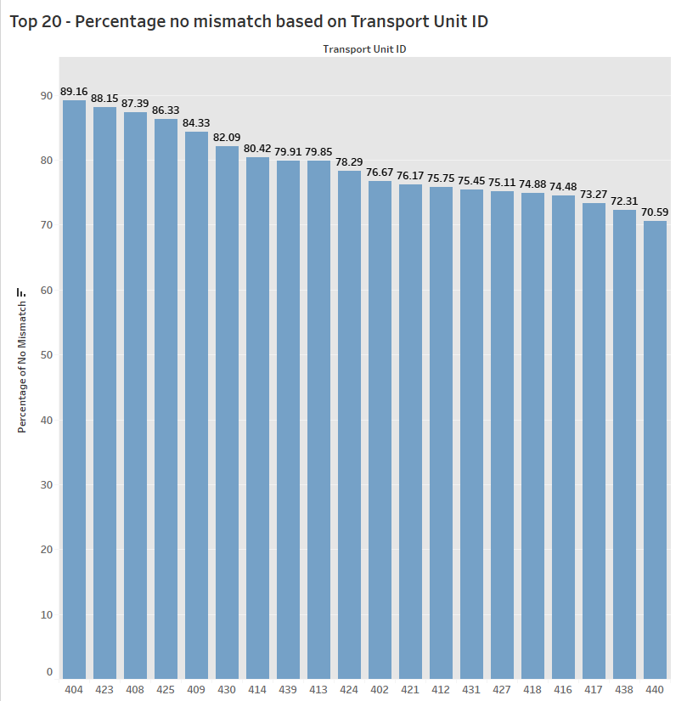
TEAM SMART WORKERS- ANALYSIS
Based on the “Transport Unit ID “ the % of mismatch in predictions:

Slide 18
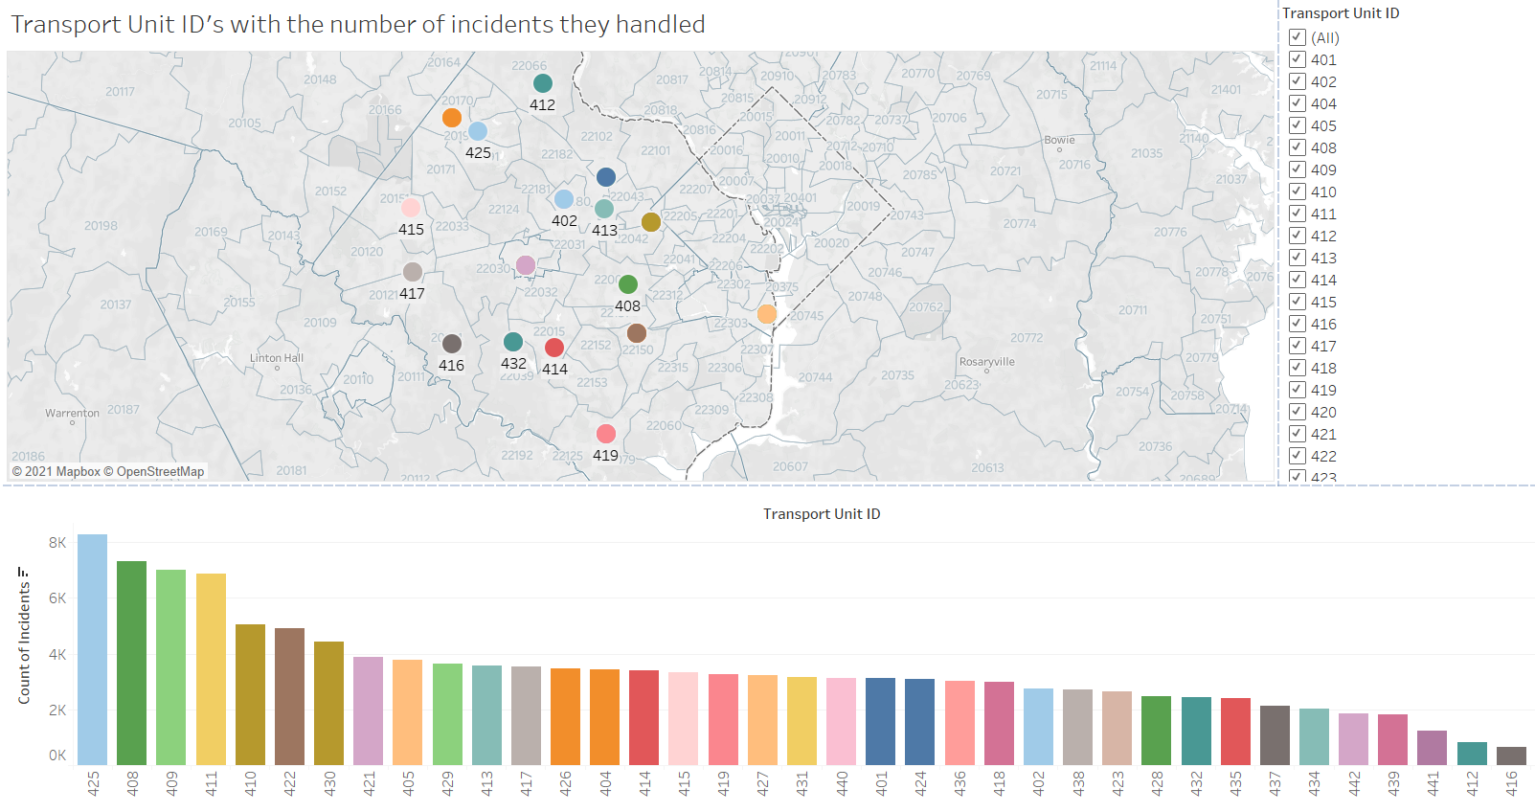
TEAM SMART WORKERS- VISUALIZATIONS

Slide 19
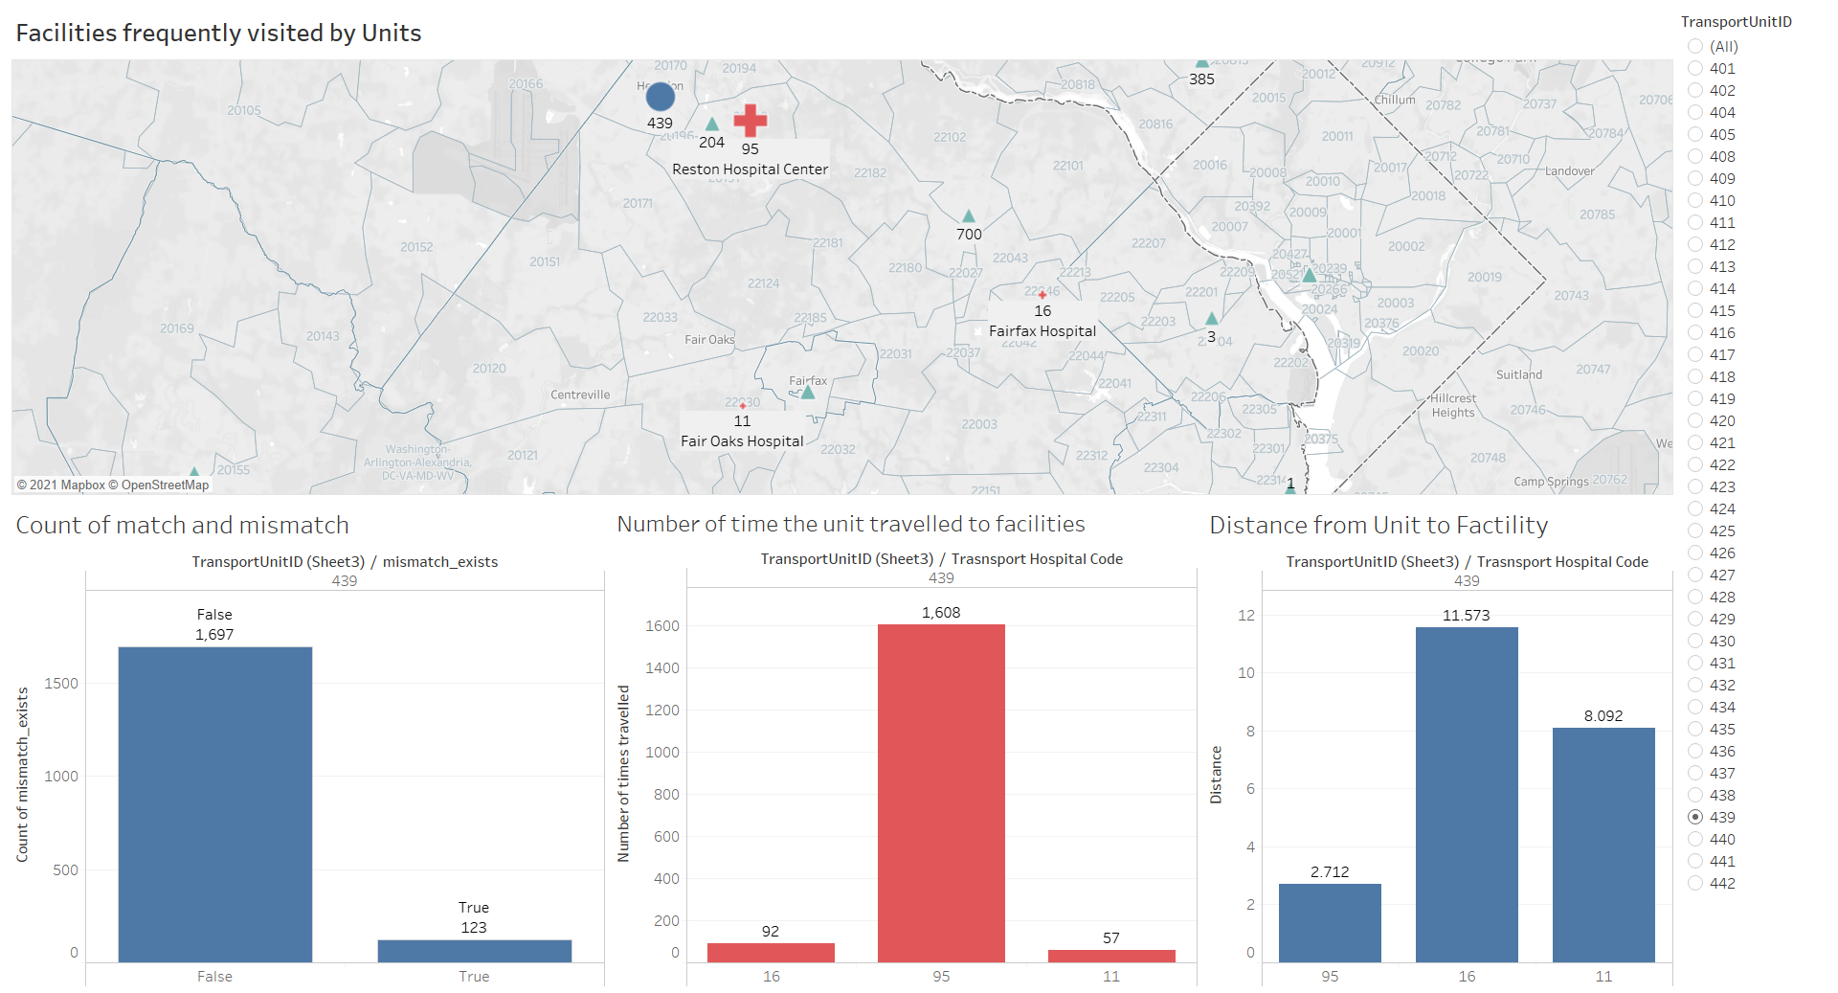
TEAM SMART WORKERS- VISUALIZATIONS

Slide 20
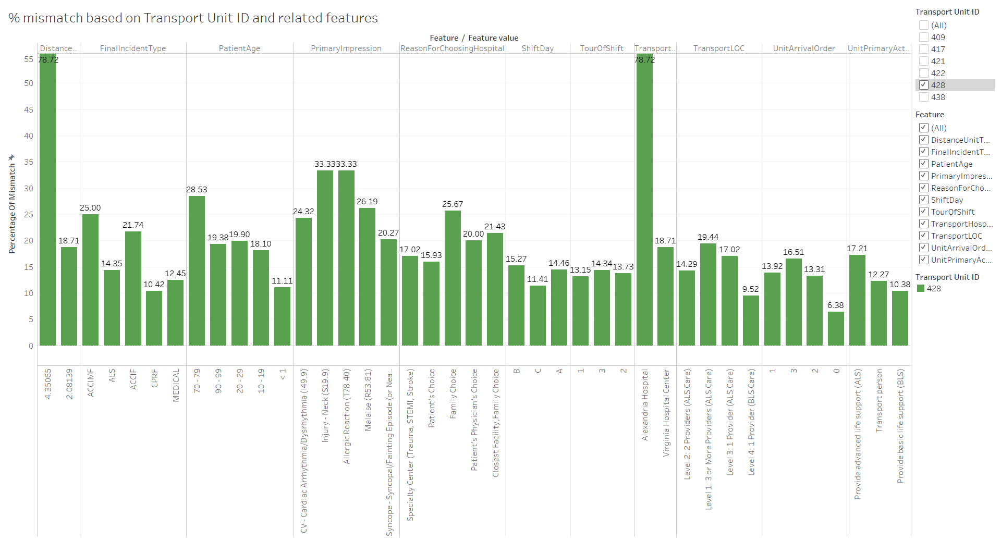
TEAM SMART WORKERS- VISUALIZATIONS

Slide 21
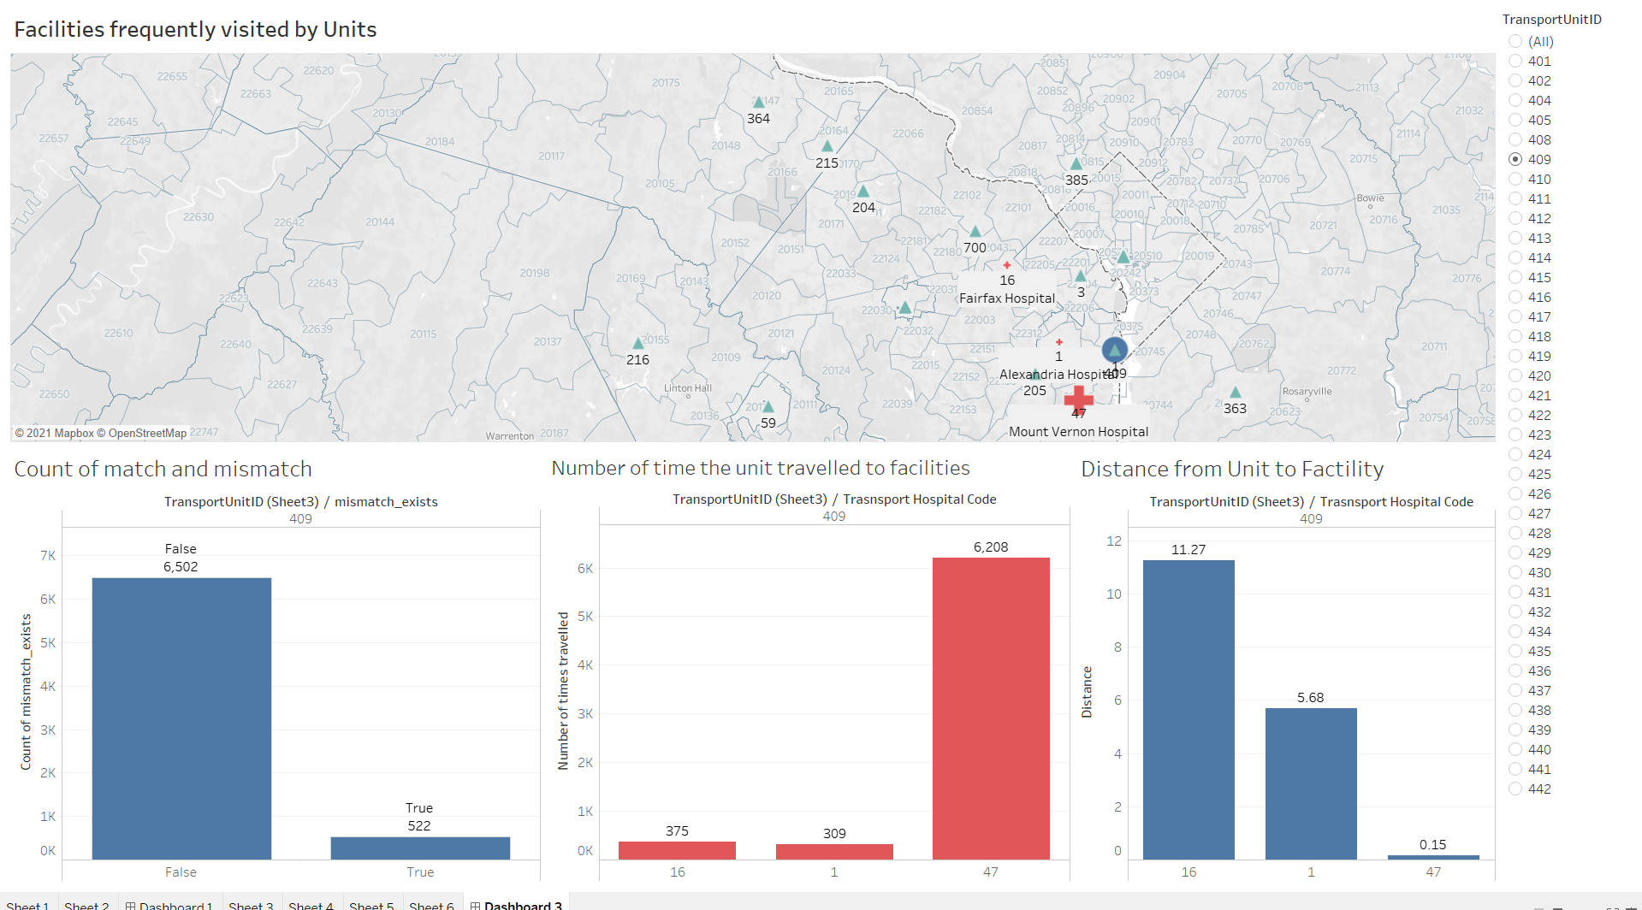
TEAM SMART WORKERS- ANOMALIES USING VISUALIZATION
UNIT 409

Slide 22
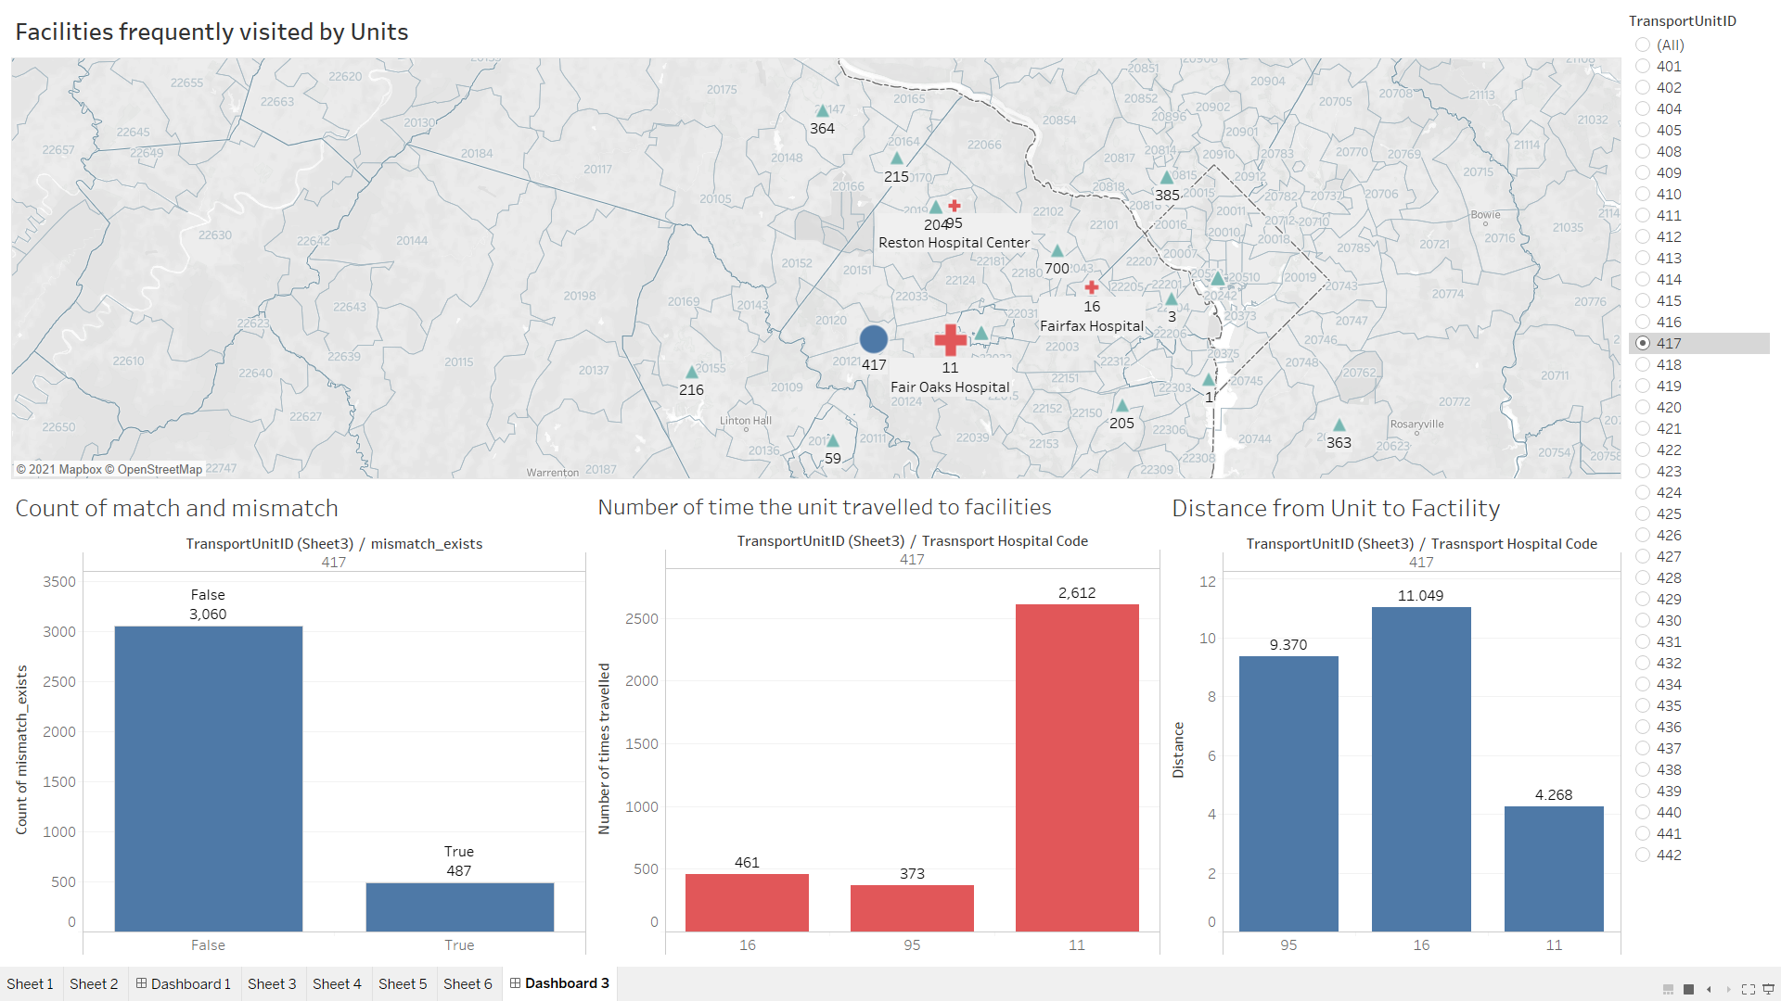
TEAM SMART WORKERS- ANOMALIES USING VISUALIZATION
UNIT 417

Slide 23
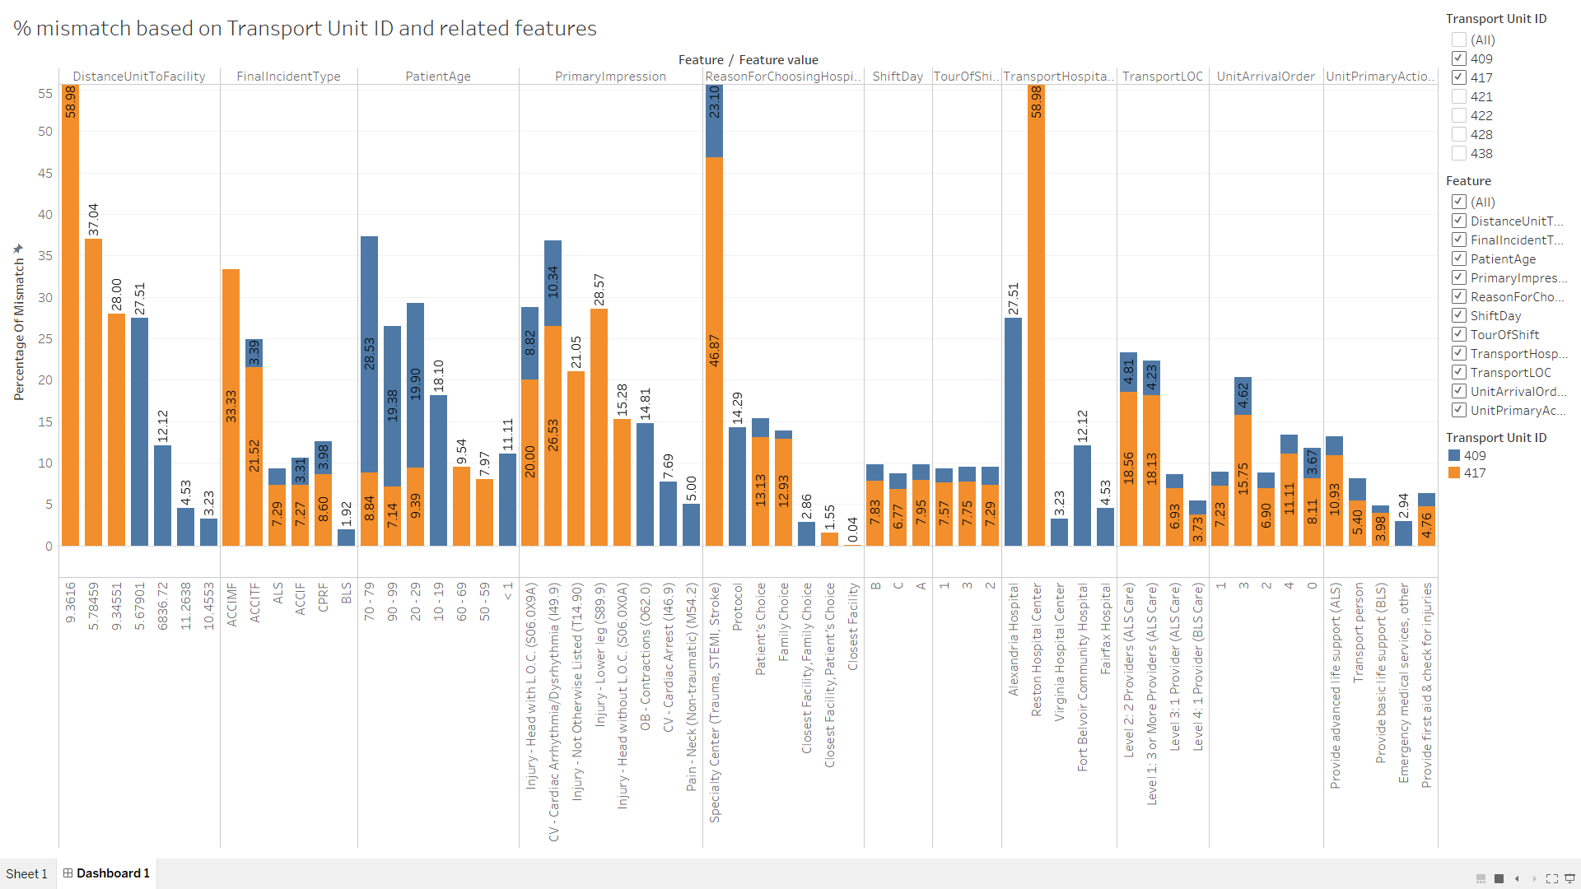
TEAM SMART WORKERS- ANOMALIES USING VISUALIZATION

Slide 24
TEAM SMART WORKERS- SUMMARY AND NEXT STEPS
Summary
Discovery of influential features affecting the transport decision making.
Found anomalies in the dataset.
Interactive and reusable visualizations.
Next Steps
Add all units in %mismatch visualization to see influencing features.
Add Medications and Procedures to model and see how much do they influence.
References
Github
Youtrack

Slide 25
TEAM SMART WORKERS- QUESTIONS
ANY
QUESTIONS?

